Slide 1
CSE-3109 Computer Architecture
Lecture 1
Introduction

Slide 2
References
Computer Architecture and Organization
Hayes J.P., McGraw-Hill.
Computer organization and design: The hardware/software interface
Patterson D.A., Hennessy J.L., Morgan Kaufmann.

Slide 3
About the Course
Course Code: CSE-3109
Course Title: Computer Architecture
Course Teacher: Nayeema Islam
Credit: 3
Total Marks: 100

Slide 4
Class Schedule
  Three classes per week:
  Monday : 10:00 am – 10:55 am
  Tuesday : 10:00 am – 10:55 am
  Wednesday : 11:00 am – 11:55 am

Slide 5
What is Computer Architecture?
Programmer’s view: a pleasant environment
Operating system’s view: a set of resources (hardware & software)
System architecture view: a set of components
Compiler’s view: an instruction set architecture with OS help
Microprocessor architecture view: a set of functional units
VLSI designer’s view: a set of transistors implementing logic
Mechanical engineer’s view: a heater!

Slide 6
Definition of computer Architecture
Computer architecture can be defined as a set of rules and methods that describe the functionality, management and implementation of computers. To be precise, it is nothing but rules by which a system performs and operates.
Computer architecture = Instruction set architecture + Machine organization + Hardware

Slide 7
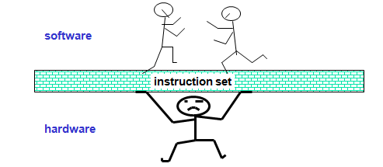
Instruction Set Architecture (ISA)
The Instruction Set Architecture (ISA) is the part of the processor that is visible to the programmer or compiler writer.
The ISA serves as the boundary between software and hardware.

Slide 8
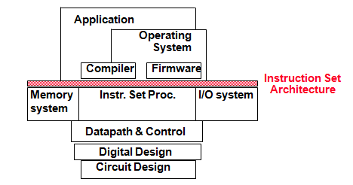
Cont.
Example: MIPS (Microprocessor without Interlocked Pipelined Stages)
Desired properties
    Convenience (from software side)
    Efficiency (from hardware side)

Slide 9
Cont.
Part of computer architecture related to programming
Define registers
  R1, R2,...
Define data transfer modes (instructions) between registers, memory and I/O
    e.g. MOV, ADD, INC
There should be sufficient instructions to efficiently translate any program
  e.g. MOV, ADD, INC

Slide 10
Machine Organization
High-level aspects of a computer’s design
  Principal components: memory, CPU, I/O, …
  How components are interconnected
  How information flows between components
  e.g. AMD Opteron 64 and Intel Pentium 4: same ISA but different organizations

Slide 11
Hardware
Detailed logic design and the packaging technology of a computer
  E.g. Pentium 4 and Mobile Pentium 4: nearly identical organizations but different hardware details

Slide 12
Types of computers and their applications
Desktop
  Run third-party software
  Office to home applications
Servers
  Modern version of what used to be called mainframes, minicomputers and supercomputers
  Large workloads
  Built using the same technology in desktops but higher capacity
    Expandable
    Scalable
    Reliable
  Large spectrum: from low-end (file storage, small businesses) to supercomputers (high end scientific and engineering applications)
    Gigabytes to Terabytes to Petabytes of storage
  Examples: file servers, web servers, database servers

Slide 13
Cont.
Embedded
  Microprocessors everywhere! (washing machines, cell phones, automobiles, video games)
  Run one or a few applications
  Specialized hardware integrated with the application
  Usually stringent limitations (battery power)
  High tolerance for failure
  Becoming ubiquitous
  Engineered using processor cores
    The core allows the engineer to integrate other functions into the processor for fabrication on the same chip
    Using hardware description languages: Verilog, VHDL

Slide 14
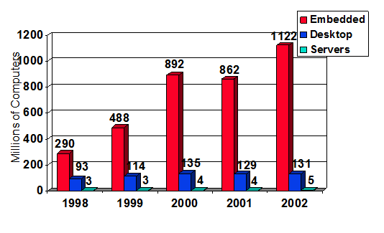
What is the Market ?

Slide 15
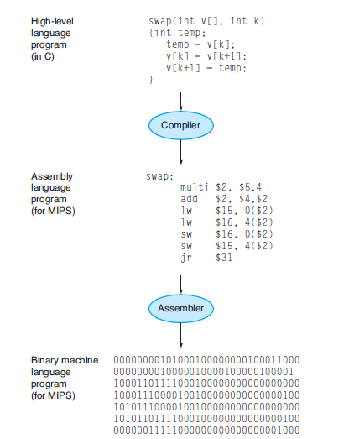
From a High-Level Language to the Language of Hardware

Slide 16
Evolution…
In the beginning there were only bits… and people spent countless hours trying to program in machine language
01100011001 011001110100
Finally before everybody went insane, the assembler was invented: write in mnemonics called assembly language and let the assembler translate (a one to one translation)
Add A,B

Slide 17
Evolution…Cont.
Assembler is a program that translates a symbolic version of instructions into the binary version.
This program translates a symbolic version of an instruction into the binary version. For example, the programmer would write
add A, B
and the assembler would translate this notation into
1000110010100000
This instruction tells the computer to add the two numbers A and B.

Slide 18
Evolution…Cont.
The name coined for this symbolic language, still used today, is assembly language. In contrast, the binary language that the machine understands is the machine language.
Assembly language requires the programmer to write one line for every instruction that the computer will follow, forcing the programmer to think like the computer.
This wasn’t for everybody, obviously… (imagine how modern applications would have been possible in assembly), so high-level language were born (and with them compilers to translate to assembly, a many-to-one translation)

Slide 19
Evolution…Cont.
A compiler enables a programmer to write this high-level language expression:
A+B
The compiler would compile it into this assembly language statement:
add A,B
The assembler would translate this statement into the binary instructions that tell the computer to add the two numbers A and B.

Slide 20
Benefits of High Level Programming Language
First, they allow the programmer to think in a more natural language, using English words and algebraic notation, resulting in programs that look much more like text.
Moreover, they allow languages to be designed according to their intended use. Hence, Fortran was designed for scientific computation, Cobol for business data processing, Lisp for symbol manipulation, and so on.
There are also domain-specific languages for even narrower groups of users, such as those interested in simulation of fluids, for example.

Slide 21
Cont.
The second advantage of programming languages is improved programmer productivity.
Programming productivity describes the degree of the ability of individual programmers or development teams to build and evolve software systems.

Slide 22
Cont.
The final advantage is that programming languages allow programs to be independent of the computer on which they were developed, since compilers and assemblers can translate high-level language programs to the binary instructions of any computer.
These three advantages are so strong that today little programming is done in assembly language.

Slide 23
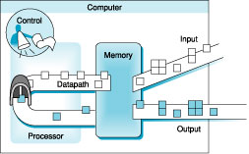
Organization of a Computer

Slide 24
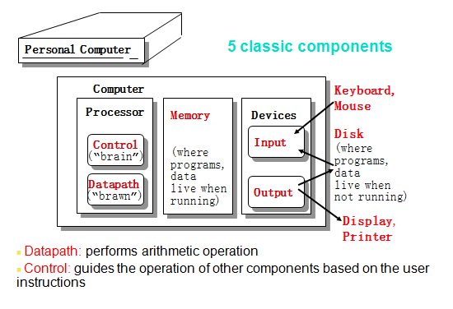
Anatomy of a Computer

